Slide 1

COVID-19 I-NET : A Novel DEEP LEARNING BASED MODEL to Analyse COVID-19 INFECTION SEVERITY using CHEST X-RAY and CT IMAGES
Rajeshkumar K(211417104213)
Prasanna Venkatesan A(211417104193)
Karthikeyan V(211417104111)
GUIDE : Shanmuganathan M
DESIGNATION: Assistant Professor
DOMAIN : DEEP LEARNING

Slide 2
INTRODUCTION
COVID-19 pandemic is affecting numerous lives all around the world. Effective care and treatment planning for COVID-19 infected patients are mandatory. This infectious virus caused by severe acute respiratory syndrome corona virus 2 (SARS-CoV-2) requires primary investigation to access infection severity progression.
The assessment metrics of COVID-19 infected patients involve lung involvement and opacity extent from CXR (Chest X-ray images) and CT scan. CXR (Chest x-ray images) are preferred over CT scans because of inferring a feasibly possible solution available to infected patients. We also analyzed CT scans of infected individuals to gain insights on progression.
The proposed model (COVID-19 I-NET a deep convolution neural network) using Chest X-ray NET and U-NET architecture resulted in image segmentation of infected areas from CXR and CT scan images respectively. A system-aided method is used for the assignment of scores to infection severity and progression on CXR. Deep learning neural architecture are evaluated and tabulated upon CXR and CT scan images. The segmentation results are promising and leading to be used as a tool for accessing image segmentation, heat map, lung area progression, and opacity of infected regions.

Slide 3
LITERATURE SURVEY
Author | Title | Source | Findings
Lucas Teixeira | Impact of lung segmentation on the diagnosis and explanation of COVID-19 in Chest X-Ray images | https://arxiv.org/pdf/2009.09780.pdf | the classification using three well-known CNN architectures: VGG, ResNet, and Inception.
A. Wong | COVID-Net S: deep neural networks for geographic extent and opacity extent scoring of chest X-rays for SARS-CoV-2 lung disease severity | https://arxiv.org/pdf/2005.12855.pdf | Deep neural networks yielded R2 of 0.664 ± 0.032 and 0.635 ± 0.044 between predicted scores and radiologist scores
Dominik Müller | Automated Chest CT Image Segmentation of COVID-19 Lung Infection based on 3D U-Net | https://arxiv.org/ftp/arxiv/papers/2007/2007.04774.pdf | Our method focuses on on-the-fly generation of unique and random image
Kiran Purohit | COVID-19 Detection on Chest X-Ray and CT Scan Images Using Multi-image Augmented Deep Learning Model | https://www.biorxiv.org/content/10.1101/2020.07.15.205567v2.full | CNN based multi-image augmentation technique for detecting COVID-19 in chest X-Ray and chest CT scan

Slide 4
TECHNOLOGY STACK
HARDWARE:
Processor - Intel Core i5.
RAM - 8 GB.
Hard Disk – 1TB.
SOFTWARE:
Operating System - Windows 7/8/10.
Environmental Setup: PyCharm/Anaconda Navigator , Docker Desktop.
Interactive Notebook Used : Kaggle/Google Colab.

Slide 5
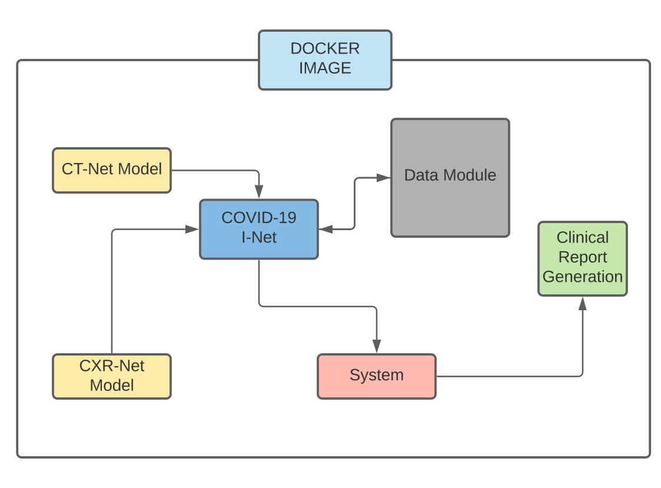
SYSTEM ARCHITECTURE

Slide 6
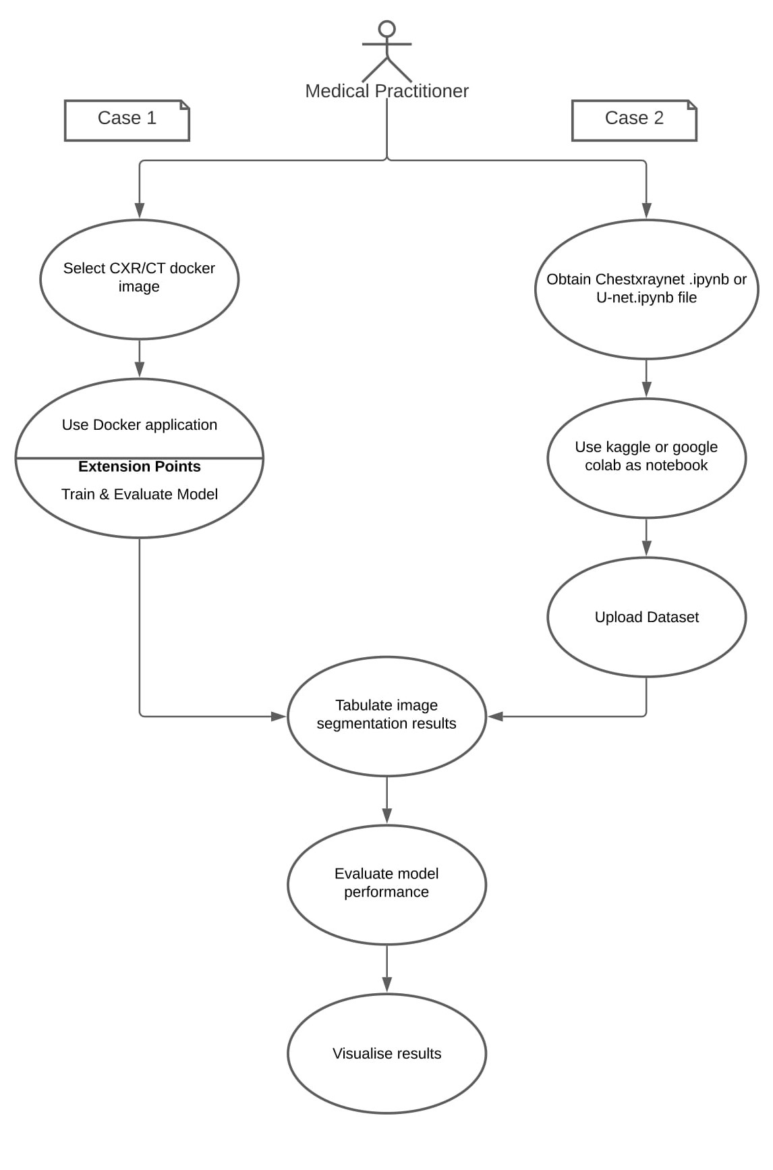
SYSTEM DESIGN
Use Case Diagram

Slide 7
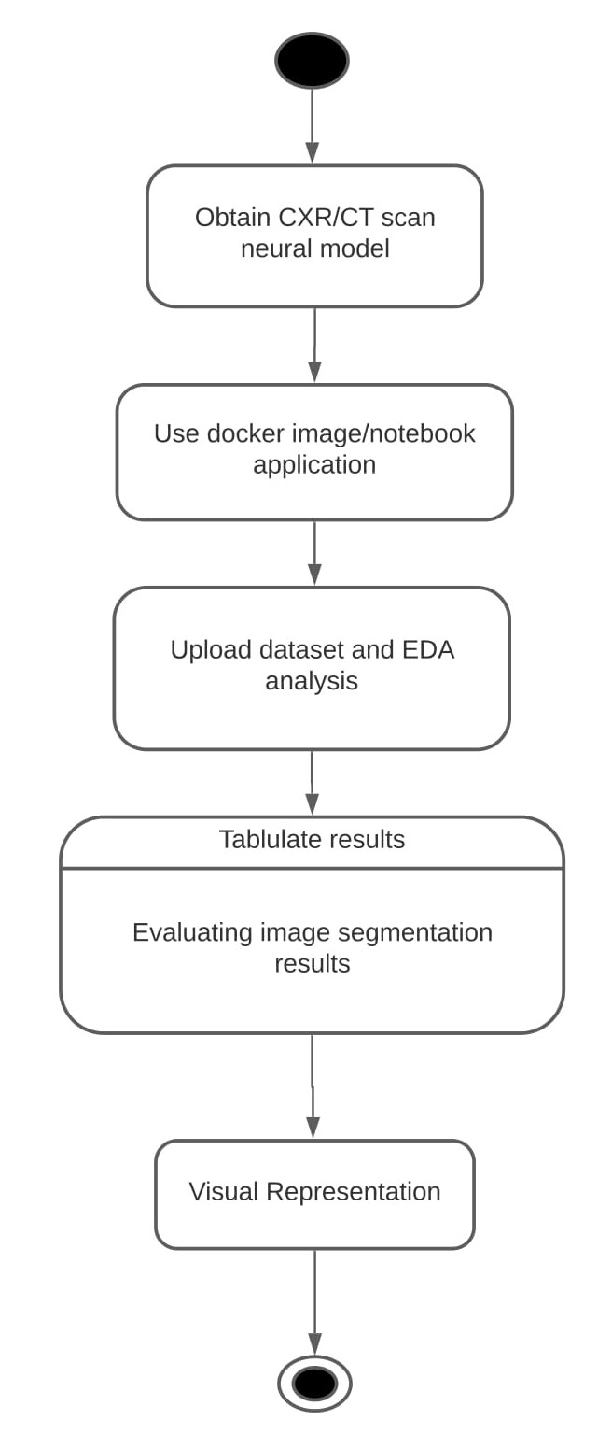
SYSTEM DESIGN
Activity Diagram

Slide 8
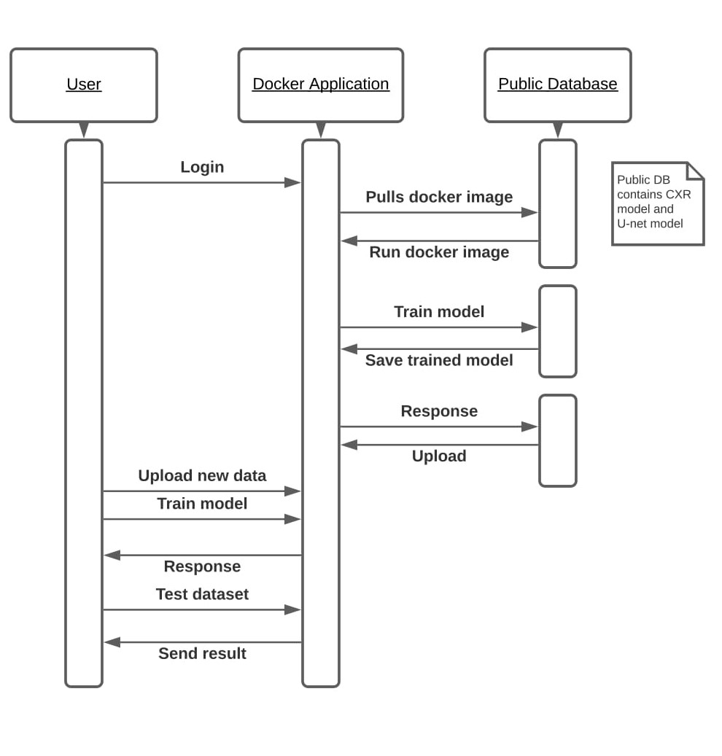
SYSTEM DESIGN
Sequence Diagram

Slide 9
MODULE DESCRIPTION – CHEST X-RAY
CheXNet is a 121 layer DenseNet developed by Stanford researchers that can detect pneumonia from chest X-rays at a level exceeding practicing radiologists. The weights of the model are uploaded into this notebook and used to train on our data to classify normal vs opacity (typical, atypical, indeterminate) cases. Contrast Limited Adaptive Histogram Equalization (CLAHE) is used for preprocessing and some augmentation techniques are applied. For interpretability, GRAD-CAM is used to see if the model is paying attention to the opacities (comparing to the ground truth bounding boxes).
cheXNet is used as a base architecture, fine tuned pre-trained neural net using Adam optimiser. Image generators and augmentations.

Slide 10
MODULE DESCRIPTION- CT SCAN
The U-Net CNN architecture is a fully convolutional network (FCN) that has two main components: a contraction path, also called an encoder, which captures the image information; and the expansion path, also called decoder, which uses the encoded information to create the segmentation output. We used the U-Net CNN architecture with changes: we included dropout and batch normalization layers in each contracting and expanding block. These additions aim to improve training time and reduce overfitting.
CT based lung segmentation using U-net architecture produced optimal results, in comparison with other neural networks. U-Net architecture for multiclass CT medical image segmentation produced far more results than SegNet

Slide 11
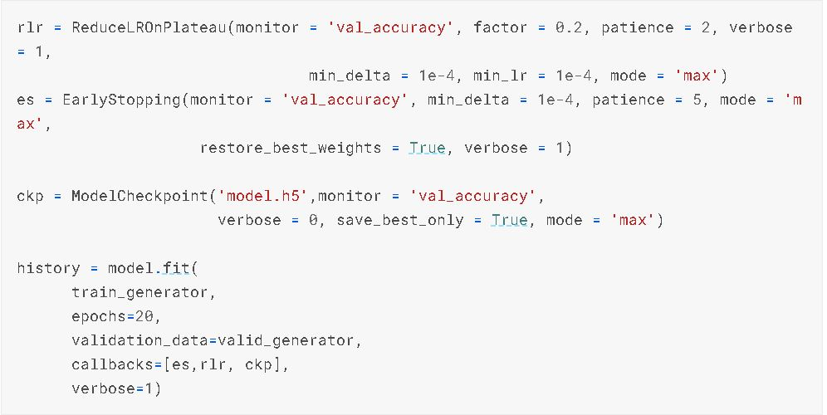
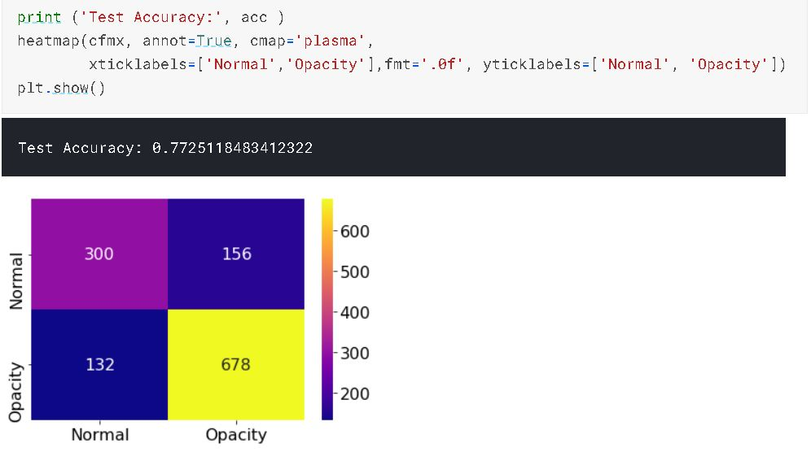
Chest X-Ray Net Performance Evaluation

Slide 12
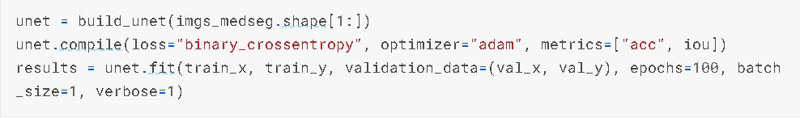
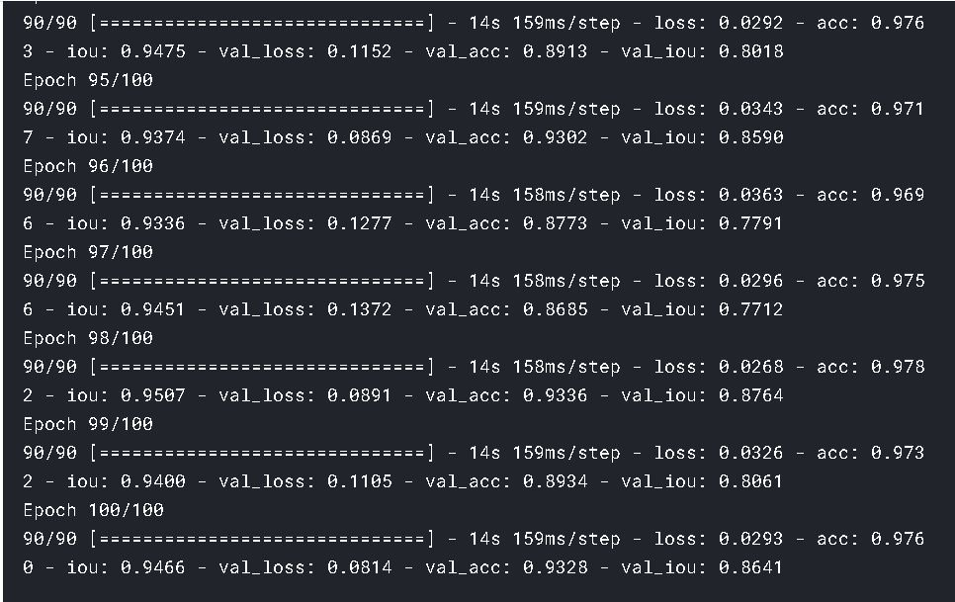
U-NET Model Performance Evaluation

Slide 13
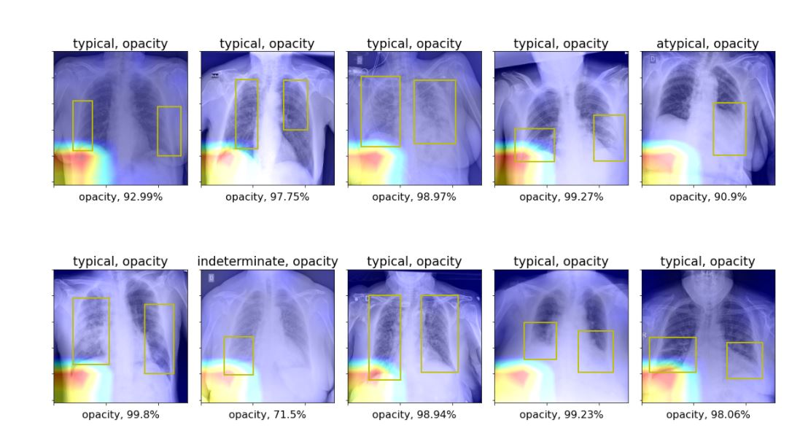
SCREENSHOTS
Chest X-ray Model:(3 Abnormalities : Typical, Atypical and Normal)

Slide 14
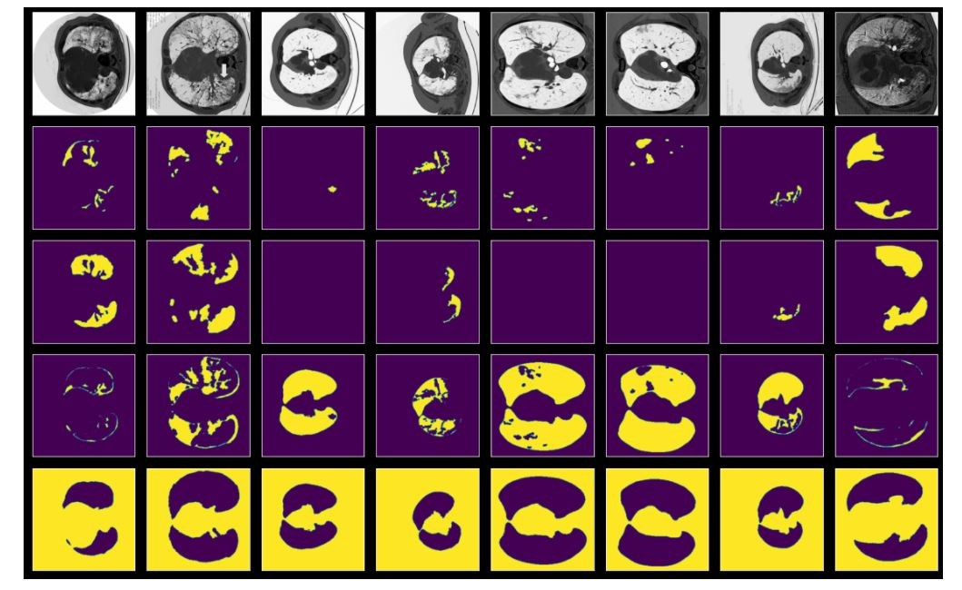
SCREENSHOTS
U-NET Model:
1. Masked Images: Image Localisation

Slide 15
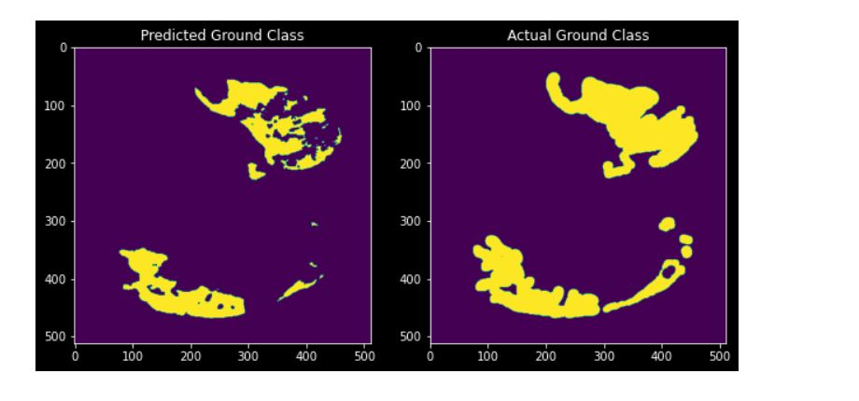
SCREENSHOTS
2. Ground Truth Images:
Ground truth is a term used in statistics and machine learning that means checking the results of machine learning for accuracy against the real world.

Slide 16
CONCLUSION
In this study, we hypothesized that computer-aided deep learning algorithms can accurately predict infection severity on CXRs and CT scan associated with COVID-19 against expert chest radiologist ground level check-up, and the results of the study support this hypothesis. Results from the stratified Monte Carlo cross-validation experiments showed that the learned Covid I-Net deep neural networks could achieve mean R2 between predicted scores and radiologist scores for geographic extent and opacity extent greater than 0.5 when evaluated for 100 different subsets of CXR and CT data.
The researchers introduced a scoring scheme for severity analysis of COVID19 by adapting and simplifying the Radiographic Assessment of lungs, where each lung was divided into three zones and each zone was assigned a binary score based on opacity, with the final severity score being the collection of the scores from the different zones. Considering the massive number of infected patients and the radiologists that are needed to analyze them, the use of artificial intelligence enabled automated severity scoring has strong potential to assist in clinical workflow efficiency given the situation.

Slide 17
REFERENCES
Literature:
Chest x-ray : https://arxiv.org/pdf/2005.12855.pdf
CT scan: https://bmcmedimaging.biomedcentral.com/track/pdf/10.1186/s12880-020-00529-5.pdf
Dataset:
Chest x-ray : https://www.kaggle.com/c/siim-covid19-detection/data
CT scan : https://www.kaggle.com/c/covid-segmentation/code
Code:
https://github.com/lindawangg/COVID-Net
https://www.kaggle.com/sinamhd9/chexnet-fine-tuned-model-interpretation
https://www.kaggle.com/piantic/siim-fisabio-rsna-covid-19-detection-basic-eda
https://www.kaggle.com/ayuraj/train-covid-19-detection-using-yolov5

